Slide 1
Digital Image processing
Prof Arbind Kumar Gupta

Slide 2
Digital Image Types
Gray Scale Images – Each pixel stores the average brightness of image area as an 8 bit number (256 gray levels) where 0 represents black and 255 represents white
Indexed Color Images – Here each pixel is an 8 bit number and each number is mapped to one color (Typically 256 colors). Used to store color images with limited range of colors.
RGB Color Images – Each pixel stores 3 bytes, one for each color component - Red, Green and Blue channels with 256 levels in each channel. Thus it can present millions of color
Binary Images – Each pixel is stored as 1 bit and has only two levels – Black or White. Used to store images which do not have many shades and saves space (eg text image)

Slide 3
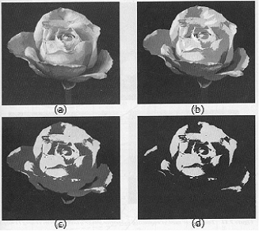
Gray Scale Images
Different Gray Levels for the same image – 256, 128, 64 and 2

Slide 4
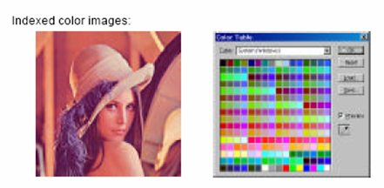
Indexed Color Images

Slide 5
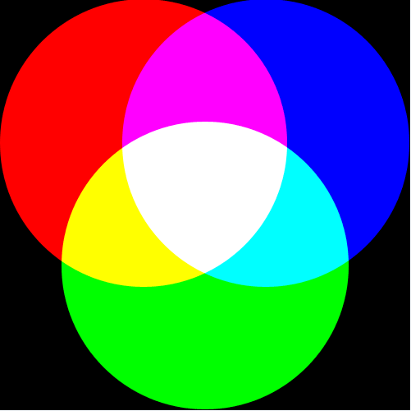
RGB Color Images

Slide 6
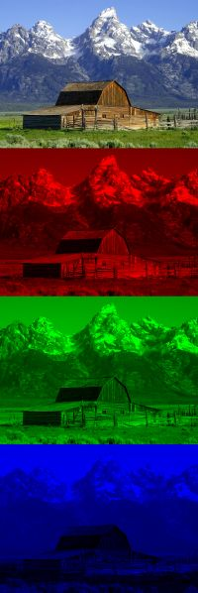
RGB Image Example
R, G and B scales and the combined image

Slide 7
Binary Image
Binary images are images whose pixels have only two possible intensity values.
Advantages of Binary Images are:
Smaller memory requirements
Faster execution time
Many techniques developed for these systems are also applicable to vision
systems which use gray scale images
Less expensive

Slide 8
Connectedness Criteria &Path Distance measure
A pixels p (x, y) is connected to a pixel q (s, t) if
they are connected, ie, a path (of distinct pixels) from p to q exists
(x₀ , y₀), (x₁, y₁) , … (x_{i}, y_{i}) , …, (x_{n}, y_{n}), where (x, y) = (x₀ , y₀) & (s, t) = (x_{n}, y_{n})
such that (x_{i-1}, y_{i-1}) is in the neighbor of (x_{i}, y_{i}) for all I = 1 to n,
For any pixel p in an image subset S, the set of pixels in S that are connected to p are called connected component of S.
Two image subsets S₁ and S₂ are connected if some pixel in S₁ is adjacent to another pixel in S₂.

Slide 9
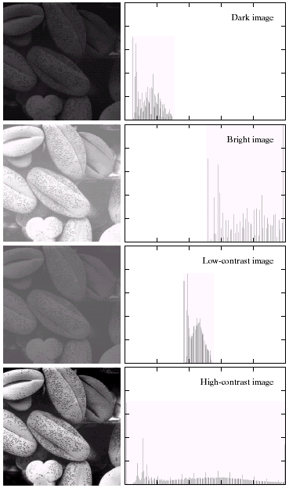
Histogram
Histogram is a graph showing the number of pixels in an image at each different intensity value found in that image.
For an 8-bit grayscale image there are 256 different possible intensities, so the histogram will graphically display 256 numbers showing the distribution of pixels amongst those grayscale values

Slide 10
Normalized Histogram
Histogram hist for an image im is calculated as
hist = np.zeros((H, W))
for r in range(H): # where H is number of rows
for c in range (W) # where W is number of colums
hist [
Normalized histogram is the histogram in which the number of pixels for each intensity level is divided by the total no. of pixels in the image.

Slide 11
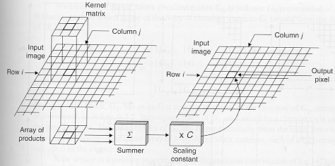
Correlation Using a Mask or Template
For each pixel in the input image, the mask is conceptually placed on top of the image with its origin lying on that pixel.
The values of each input image pixel under the mask are multiplied by the values of the corresponding mask weights.
The results are summed together to yield a single output value that is placed in the output image at the location of the pixel being processed on the input.

Slide 12
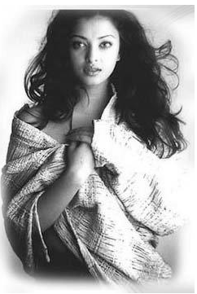
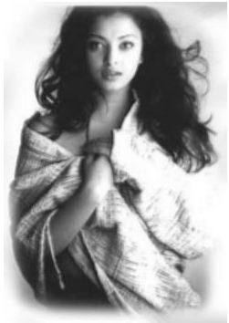
Example for Masking / Neighborhood Averaging
Original Image
Neighborhood Averaged Image

Slide 13

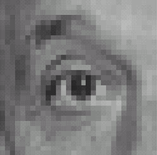
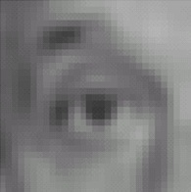
Averaging and Smoothening
1
1
1
Image averaging - If m(x, y) is all 1 then the convolution results in averaging of an image.
It is useful in reducing noise but makes the image blurred
The mask h can be of any size, bigger the mask, more is the blurring
1
1
1
1
1
1
“box filter”
Original
Blur (with a
box filter)
Notes:
Gaussian Filtering
Standard Deviation The Standard deviation of the Gaussian function plays an important role in its behaviour. The values located between +/- σ account for 68% of the set, while two standard deviations from the mean (blue and brown) account for 95%, and three standard deviations (blue, brown and green) account for 99.7%. account for 99.7%.

Slide 14

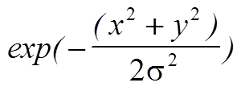
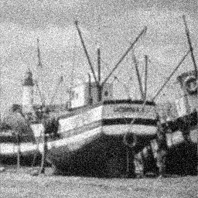


Averaging and Smoothening
Gaussian smoothening
Smoothening - If the mask is a non-uniform mask (like a centre weighted or a Gaussian filter) then it becomes smoothening.
It is a low pass filter
Reduces noise and eliminates small details
Smoothening effect is better than averaging due to Gaussian distribution
Original with noise
Filtered , σ=1.5
Filtered, σ=3.0
Notes:
Gaussian filter mask
1 4 7 4 1
4 16 26 16 4
7 26 41 26 7
4 16 26 16 4
1 4 7 4 1
0.00 0.01 0.03 0.01 0.00
0.01 0.06 0.10 0.06 0.01
0.03 0.10 0.15 0.10 0.03
0.01 0.06 0.10 0.06 0.01
0.00 0.01 0.03 0.01 0.00

Slide 15
Segmentation

Slide 16
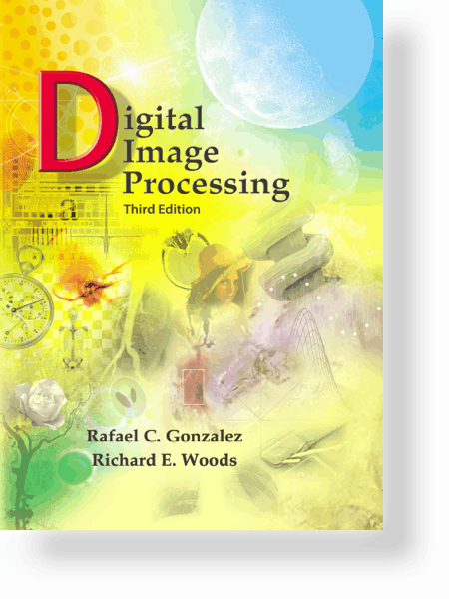
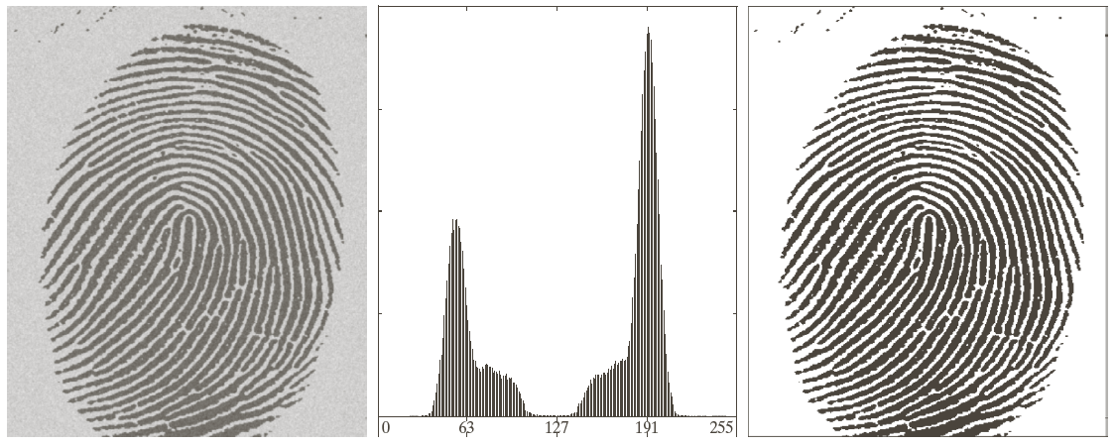
Digital Image Processing, 3rd ed.
Gonzalez & Woods
Thresholding
www.ImageProcessingPlace.com
Consider the fingerprint image that we want to process for matching. It will be required to separate the ridges from the background for feature extraction.
This can be done by thresholding the image into two regions.
A simple thresholded image g(x, y) is defined as
g(x, y) = 1 if f(x, y) > T denoting foreground object 0 if f(x, y) <= T denoting background object

Slide 17
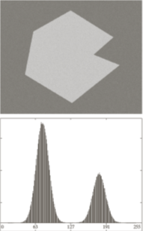
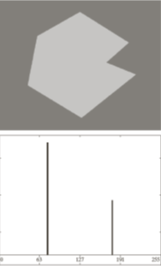
Thresholding
Thresholding is a common technique for separating foreground object (one or more) from background so that further processing can be done.
One simple way is to select a threshold T such that any point for which f(x, y) > T is an object point, and background point otherwise.
Thresholding can be defined as an operation that involves test against a function T = T(x, y, p(x, y), f(x, y)) where f(x,y) is the gray level intensity of a point (x, y) and p(x, y) is some local property of this point.
when T depends only on f(x, y) then it is called global thresholding.
If it also depends on p(x, y) then it is called local thresholding.
If T also depends on the coordinates (x, y) then it is called dynamic or adaptive thresolding

Slide 18
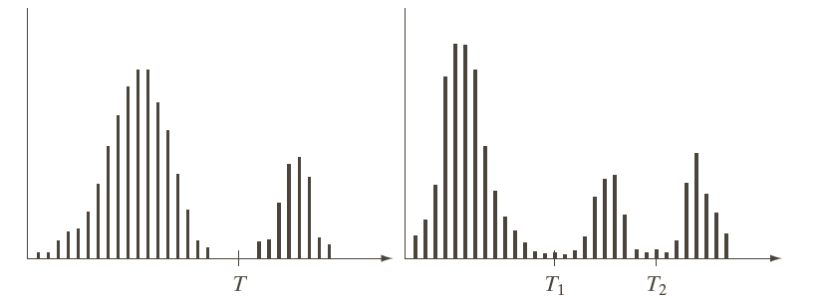
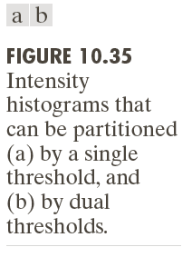
Digital Image Processing, 3rd ed.
Gonzalez & Woods
www.ImageProcessingPlace.com
Basic Global thresholding – Partition the histogram into two by using an initial estimate of threshold T
Scan the image pixel by pixel to map them into foreground or background pixels.
Compute the average intensity of foreground and background pixel as μ_{f} and μ_{b}.
Compute the new threshold T as (μ_{f} + μ_{b}) / 2.
Do it iteratively till T converges
Multilevel global thresholding
Same as earlier except that you use two thresholds T₁ and T₂.

Slide 19
Edge Types
Step Edges
Roof Edge
Line Edges

Slide 20
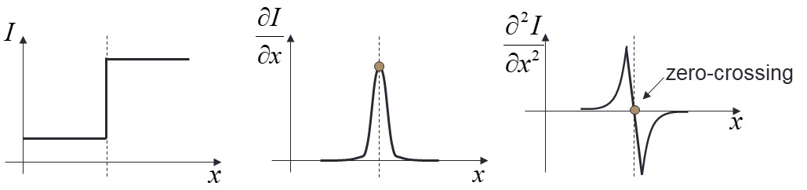
General theory of edge detection
Point, Line and boundaries are all discontinuities and called edge.
Let f(x, y) be the image function in x and y direction
Then first order derivative is
∂f / ∂x = f’(x, y) = f( x+1, y) – f(x, y) & ∂f / ∂y = f’(x, y) = f( x, y+1) – f(x, y)
And Second order partial derivatives:

Slide 21
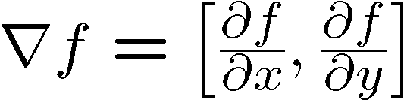
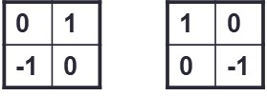
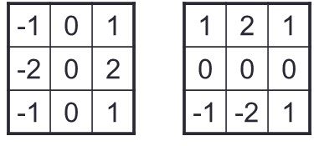
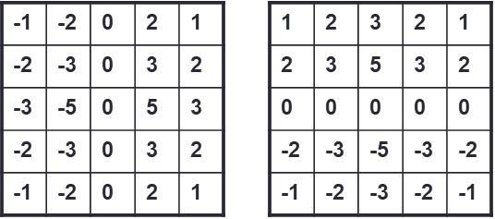
Comparing Edge Operators
Good Localization
Noise Sensitive
Poor Detection
Gradient:
Roberts (2 x 2):
Prewitt (3 x 3):
Sobel (3 x 3):
Sobel (5 x 5):
Poor Localization
Less Noise Sensitive
Good Detection

Slide 22
Region growing
Region growing is a procedure that groups pixels or subregions into larger regions based on predefined crieterias.
It starts with a set of seed points and from these grow regions by appending to each seed those neighbouring pixels that have properties similar to the seed (such as specific ranges of gray values, texure or colour).
The seed points are selected based on the problem at hand, or it can be selected based on a priori information. It can even be entered manually.
For each seed point, the algorithm will search for neighbouring pixels based on similarity criteria and will add them into the region if the criteria is satisfied.
The search stops when there are no more pixels left in the image for searching
The challenges are –
How to select seed points?
What similarity criterias to be used?
What global similarity (shape, moment, texure) to be used?

Slide 23
Algorithm for region growing
h, w = im.shape #im is the image to grow region
Select initial seed points and add to Q
while Q != []:
nextPt = Q.pop()
for pixel in neighbours(nextPt):
if inregion(pixel):
oim[pixel] = 1
Q.append(pixel)

Slide 24
Template Matching
Idea: you are looking for an exact match of an object (described by a sub-image, a template) in an image
Ideal world: it matches exactly
Algorithm:
Evaluate a match criterion at every image location (and size, reflection, and rotation, if those variations are expected)
A “match” is a local maximum of the criterion above a threshold
One match criterion:
Just the dot product between the template and a neighborhood in the image.
Idea: high correlation when the template matches.
Problem: always high correlation when matching with a plain bright region
Solution: Normalize the template and each region by subtracting each’s mean from itself before taking dot product

